Slide 1
Blackboard writing Audio Recognizer
Word Inference Demo Video
2018 Spring EE474 Introduction to Multimedia
Group 5 (HyoJun Lim, Inyong Koo, Hyunji Kim)

Slide 2
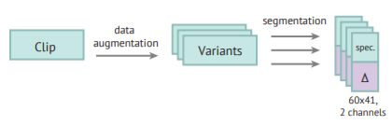
Network configuration
We extracted mel-scaled spectrogram (spec.) and its delta features ($Δ$) from our samples.
(# of samples : 4,179 / batch size 60x41)
Karol J. P. (2015). Environmental sound classification with convolutional neural networks. IEEE International workshop on machine learning for signal processing, 2015, 17-15

Slide 3
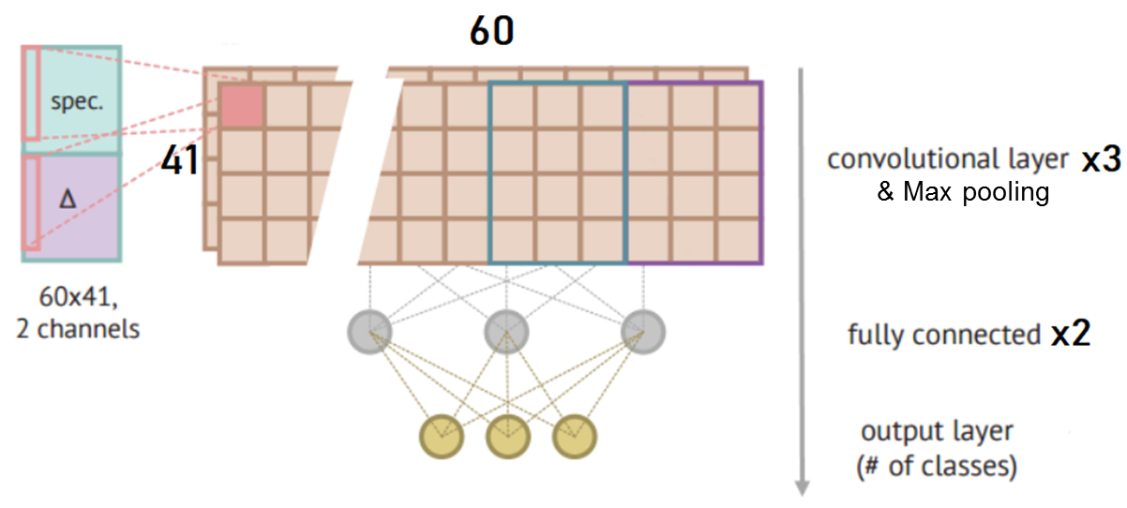
Network configuration
Network Specification
- Loss function: softmax_cross_entropy_with_logits - Optimizer: AdamPropOptimizer
- Activation function: Relu - keep_prob: 0.8
- Softmax classification - Learning rate: 0.008
We trained a CNN network with 3 convolutional layers and 2 fully connected layers.

Slide 4
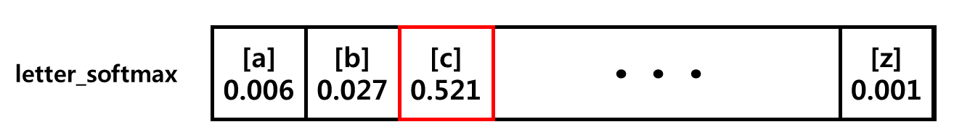
Inference
prediction : ‘C’
For an input, network produce a letter_softmax vector and a prediction.
letter_softmax is a 1-by-26 vector containing probability value of each character (‘A’ to ‘Z’)
prediction is the most probable character.

Slide 5
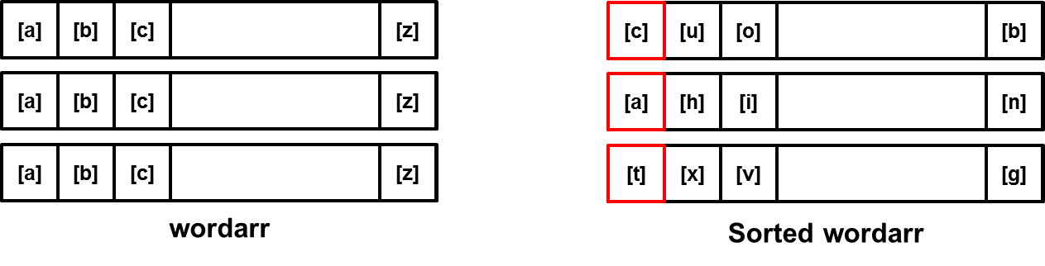
Inference
prediction : ‘C’
Multiple input results a wordarr, which is a series of letter_softmax vectors.
If we sort each row of wordarr by probability value, then the first element of every row is the prediction character for corresponding position.

Slide 6
PART I
Examples of finding correct result by precise inference

Slide 7
Written word : BED
Inference Result : BED
(여기에 BED 영상)

Slide 8
Written word : DEAD
Inference Result : DEAD
(여기에 DEAD 영상)

Slide 9
Word validation – Searching rule
Look up the most probable letter combination
Try combinations by changing each letter to
next probable letter
[z]
[d]
[n]
[b]
[z]
[d]
[n]
[b]
[u]
[o]
[c]
[t]
[u]
[o]
[c]
[t]
[z]
[d]
[n]
[b]
[z]
[d]
[n]
[k]
[z]
[d]
[n]
[k]
[e]
[f]
[h]
[s]
[e]
[f]
[h]
[s]
[u]
[o]
[c]
[t]
[z]
[d]
[n]
[k]
[z]
[d]
[n]
[b]
[z]
[d]
[n]
[b]
[u]
[o]
[c]
[t]
[u]
[o]
[c]
[t]
[e]
[f]
[h]
[s]
[z]
[d]
[n]
[k]
[z]
[d]
[n]
[k]
Sorted wordarr
[e]
[f]
[h]
[s]
[e]
[f]
[h]
[s]

Slide 10
Word validation – Searching rule
Look up the most probable letter combination
Try combinations by changing each letter to next probable letter
Replace the most probable letter (a) that has least probability to next probable letter (b).
(add probability of (a) to probability of (b), and set probability of (a) to zero.)
[z]
0.2
[d]
0.15
[n]
[b]
[z]
0
[d]
0.35
[n]
[b]
0.01
[u]
0.6
[o]
[c]
[t]
[u]
0.6
[o]
[c]
[t]
[z]
0.3
[d]
[n]
[k]
[z]
0.3
[d]
[n]
[k]
[e]
0.95
[f]
[h]
[s]
[e]
0.95
[f]
[h]
[s]
Sorted wordarr
Sorted wordarr

Slide 11
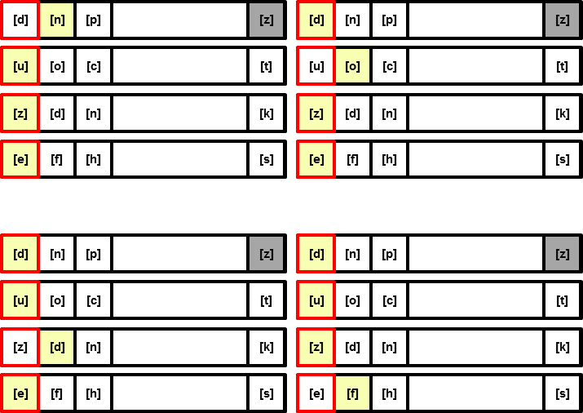
Word validation – Searching rule
Look up the most probable letter combination
Try combinations by changing each letter to next probable letter
Replace the most probable letter (a) that has least probability to next probable letter (b)
(add probability of (a) to probability of (b), and set probability of (a) to zero)
Repeat 1-3 until there are 5 valid words
[d]
[n]
[p]
[z]
[u]
[o]
[c]
[t]
[z]
[d]
[n]
[k]
[e]
[f]
[h]
[s]
Sorted wordarr

Slide 12
PART II
Examples of finding correct result through word validation

Slide 13
Written word : NONE
Inference Result : ZUZE
Validation Result : DOZE, NODE, NONE
(여기에 NONE 영상)

Slide 14
Written word : DEBUG
Inference Result : GEEOA
Validation Result : DEBUG, DEWED
(여기에 DEBUG 영상)

